Slide 1

bad Monkeys & Twisting DOmains
Jason A. Kinder
@Jakinder
https://www.linkedin.com/in/jkinder/

Slide 2
WHOAMI
Director of Cyber Security Operations for Leonardo DRS
23+ years of experience in IT & Security
Blue Teamer/Network Defender
SOC, Incident Response, Security Architecture, Forensics, Insider Threat
Bourbon, Beer, Running, Hiking & Music are some of my passions

Slide 3
disclaimer
“The opinions expressed in this presentation and on the following slides are solely those of the presenter and not necessarily those of the presenter’s employer. The presenter’s employer does not guarantee the accuracy or reliability of the information provided herein.”

Slide 4
Red Team in-a-box (entry-level)
Created by Guardicore
Specializes in network segmentation for traditional, cloud and hybrid networks
Open source attack simulation tool
https://github.com/guardicore/monkey
Web-based and easy to use
Similar to Netflix’s Chaos Monkey
Randomly terminates production services to test resiliency
https://netflix.github.io/chaosmonkey/

Slide 5
use cases
Breach & Attack Simulation (BAS)
How secure are you from and external threat?
How secure are you from your own people?
How do I test?
Work from Home assessment
Is VPN setup correctly and securely?
Is split-tunneling was allowed?
Credential Leak
Network Segmentation
Zero Trust Assessment
Should we trust all of our endpoints inherently?
What about our servers? They’re good right?

Slide 6
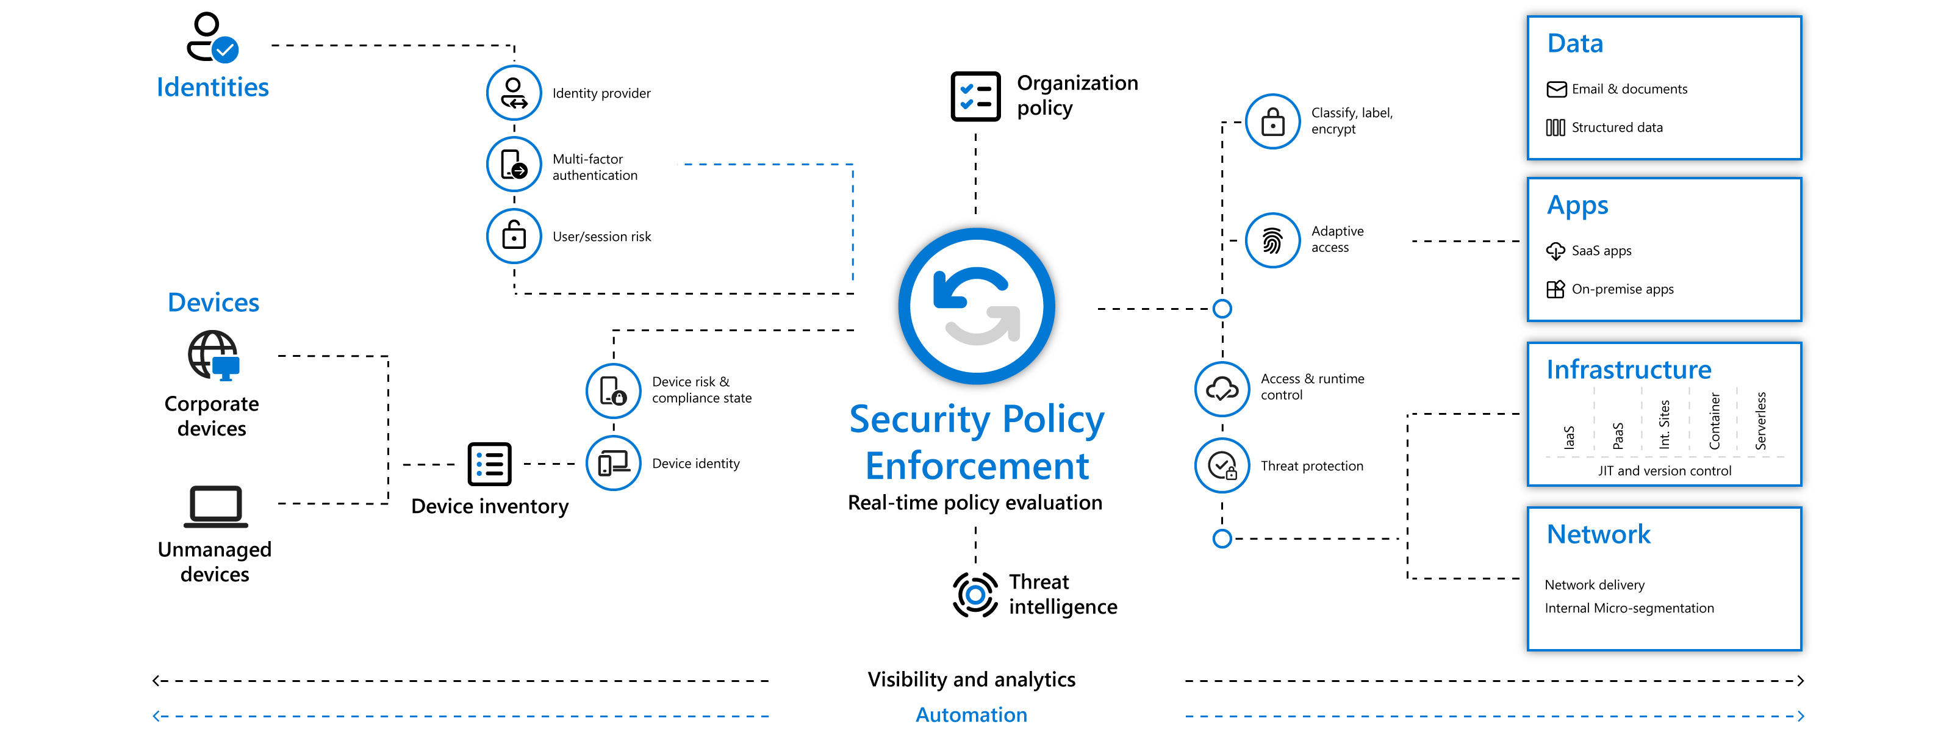
Zero Trust Overview
https://www.microsoft.com/en-us/security/business/zero-trust

Slide 7
Installation
Download from https://www.guardicore.com/infectionmonkey/#download
Server Support
Cloud environments (AWS & MS Azure)
Docker
Vmware (Fusion, Workstation, ESX)
Baremetal
Linux (Ubuntu 18.04, Debian 9)
Windows Server (Server 2012 & 2016)
Agent Support
Centos 7+
Debian 7+
Kali 2019+
Oracle 7+
RHEL 7+
SUSE 7+
Ubuntu 14+
Windows Server 2012+
Windows 7/Windows Server 2008 R2*
* if KB2999226 is installed (Universal C runtime in Windows)

Slide 8
Configuring & Running the Monkey
Deploy to chosen environment (5-10 minutes)
Web interface accessed via https://<IP address>:5000
Setup login account -or- leave open to the world
Quick run -or- configure “advanced parameters” (15 minutes+)
Run on Monkey Island server -or- separate machine

Slide 9
advanced monkey configuration (DEMO)
Configure ATT&CK techniques
Review tactics at https://attack.mitre.org/
Configure exploits to check for
Careful with MS08-067, RCE vulnerability could cause DoS crashing SVCHOST.EXE
Add usernames and passwords for brute force password attempts
Define network scan target(s) & scan depth
Configure post-breach actions
Gauge how vulnerable a system is
Collect information from vulnerable endpoints
Let the monkey run free!!!!!
On the island or off the island

Slide 10
how bad is it really?!?

Slide 11
reports (DEMO)
Breach & Attack Simulation Report
Zero Trust Report
Based on Zero Trust Framework established by Forrester
Mitre ATT&CK Report

Slide 12
Examples
External Attacker
Run from Infection Monkey server to determine spread from attacker system
Insider Threat/Compromised User
Phishing
Watering-hole
Malicious USB
Compromised User2 (WFH)
Tooling test
Does my current toolset detect none, some or all of the attacks?
Do I need to modify my detection signatures?

Slide 13


Questions?
Get that monkey off your back!

Slide 14

Blue Team recon tool for finding lookalike domains
Created by Marcin Ulikowski, @elceef
Open source https://github.com/elceef/dnstwist
CLI & Web-based w/ minimal time to find threats
Uses DNS fuzzing to find potentially malicious domains
Addition
Bitsquatting
Homoglyph
Hyphenation
Insertion
Omission
Repetition
Replacement
Subdomain
Transposition
Vowel-swap
Various

Slide 15
use cases
Typos-squatting
Impersonation
Phishing pages
Rogue MX host detection
Pre-attack indicators
Enhance SIEM indicators
https://www.splunk.com/en_us/blog/security/detecting-typosquatting-phishing-and-corporate-espionage-with-enterprise-security-content-update-s-brand-abuse-monitoring-analytic-story.html

Slide 16
User Interface
CLI
Python3 based
Requirements
python3-dnspython python3-tld python3-geoip python3-whois python3-requests python3-ssdeep
Native, Brew (macOS) & Windows Subsystem for Linux (WSL)
Web Interface
dnstwist - phishing domain scanner, https://dnstwist.it/
dnstwister - https://dnstwister.report/

Slide 17
Common CLI switches
-m, check if MX can be used to intercept emails
-r, show only registered domains
-s, compare fuzzy hash of seed domain web page to others discovered
-w, creation date lookup from WhoIS
-f, output to file (csv, json, list)
-g, geo-ip lookup of resolved IP (no longer works, was helpful when it did)

Slide 18
DEMO Time!
CLI
google.com
microsoft.com
leonardo-drs.com
dnstwist - phishing domain scanner, https://dnstwist.it/
dnstwister - https://dnstwister.report/

Slide 19
Where do we go from here?
Regular searches
Blocking and alerting from web proxy, email proxy, firewalls
Enhance SIEM detections
Request domain takedowns

Slide 20

Questions?
Time to get twisted!

Slide 21
Reference
Infection Monkey
https://www.guardicore.com/infectionmonkey/
https://www.guardicore.com/infectionmonkey/docs/usage/getting-started/
https://www.guardicore.com/infectionmonkey/wfh.html
DNStwist
https://github.com/elceef/dnstwist
Test VMs
https://developer.microsoft.com/en-us/windows/downloads/virtual-machines/
https://developer.microsoft.com/en-us/microsoft-edge/tools/vms/

Slide 22
Empowering individuals and organizations to protect themselves and fight the good fight!

